Slide 1
JAVA conditional statement
Sarower ahmmed

Slide 2
Why need to use??
To put condition in your code
Need to verify our code

Slide 3
Code value test
Verification- by condition
Validation- by useing Assert

Slide 4
How to use condition in Java
If statement
If - else statement
If-else if- else statement

Slide 5
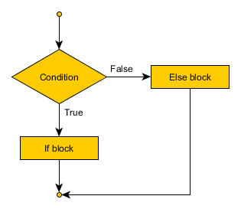
If-else statement

Slide 6
How to write condition in java coding
If(condition)
{
All code inside the curly braket
}
If condition is true than it will run the code inside { code}
If condition is false than it will not run the code inside { code}

Slide 7
If condition
public class Variable_Types {
static int myAccountBalance;
public static void main(String[] args) {
myAccountBalance=400;
if (myAccountBalance > 100 & myAccountBalance < 1000 ) {
System.out.println( "You dont have enough money");
}
Above condition is true ,so u can see console- You dont have enough money

Slide 8
False condition
If condition is false than code block will not run inside the if condition.
If condition is false than else block will run

Slide 9
If-else condition
public class Variable_Types {
static int myAccountBalance;
public static void main(String[] args) {
myAccountBalance=20000;
if (myAccountBalance > 100 & myAccountBalance < 1000 ) {
System.out.println( "You dont have enough money");
}
else {
System.out.println( "You have enough money");
Above if condition ifs false ,so else will run

Slide 10
If-else if-else condition
We can use multiple if or
We can use-
1st condition if
Next all condition with else if
When all condition false than run else

Slide 11
Try it in eclipse
public static void main(String[] args) {
myAccountBalance=1100;
if (myAccountBalance > 100 & myAccountBalance < 1000 ) {
System.out.println( "You dont have enough money");
}
else if (myAccountBalance > 1000 & myAccountBalance < 10000) {
System.out.println("You have good money");
}
else if (myAccountBalance > 10000) {
System.out.println( " You really have good savings");
}
else{
System.out.println( "You have very poor money");
}

Slide 12
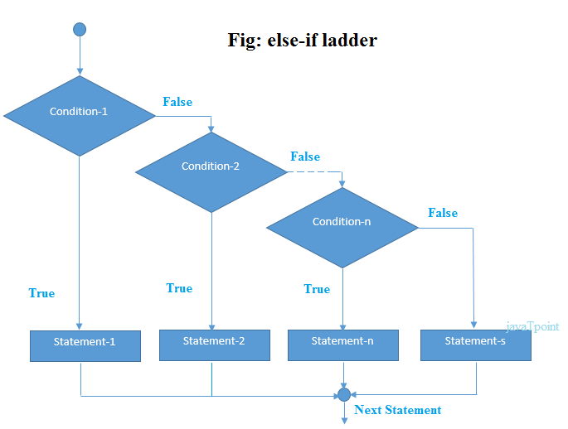
Multiple if= if-else if and else statment

Slide 13
Nested if condition
If condition inside another if condition

Slide 14
THANKS ALL

